Slide 1

Lesson01
Introduction UX/UI

Slide 2
Introduction
Good and Poor Design
What is User Experience design?
What UX Designers Do Goes Beyond UI Design
http://fpt.edu.vn

Slide 3
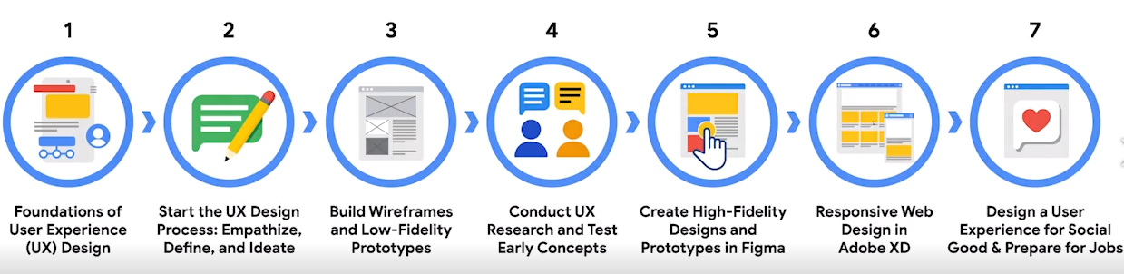
Introduction
Become a UX designer
http://fpt.edu.vn

Slide 4
1- Introduction
How many interactive products are there in everyday use? Think for a minute about what you use in a typical day: smartphone, tablet, computer, remote control, coffee machine, ATM, ticket machine, printer, iPod, GPS, e-reader, TV, electric toothbrush, radio, games console . . . the list is endless.
Now think for a minute about how usable they are. How many are actually easy, effortless, and enjoyable to use? Some, like the iPod, are a joy to use. Others, like a ticket machine, can be very frustrating.
http://fpt.edu.vn

Slide 5
Why is there a difference?
Many products that require users to interact with them, such as smartphones and social networking sites, have been designed primarily with the user in mind. They are generally easy and enjoyable to use.
Others, such as switching from viewing a rented movie on your smart TV to watching a sports channel, or setting the alarm on a digital clock, have not necessarily been designed with the users in mind, but have been engineered primarily as systems to perform set functions. While they may work effectively, it can be at the expense of how they will be used by real people.
http://fpt.edu.vn

Slide 6
2- Good and Poor Design
A central concern of interaction design is to develop interactive products that are usable. By this is generally meant easy to learn, effective to use, and providing an enjoyable user experience. A good place to start thinking about how to design usable interactive products is to compare examples of well_x0002_and poorly-designed ones.
Through identifying the specific weaknesses and strengths of different interactive products, we can begin to understand what it means for something to be usable or not.
http://fpt.edu.vn

Slide 7
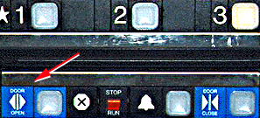
Bad designs
  Elevator controls and labels on the bottom row all look the same, so it is easy to push a label by mistake instead of a control button.
  People do not make same mistake for the labels and buttons on the top row. Why not?
www.baddesigns.com
www.id-book.com

Slide 8
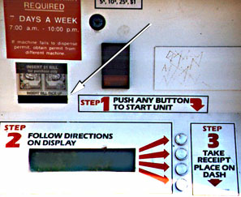
Why is this vending machine so bad?
Need to push button first to activate reader
Normally insert bill first before making selection
Contravenes well known convention
www.baddesigns.com
www.id-book.com

Slide 9
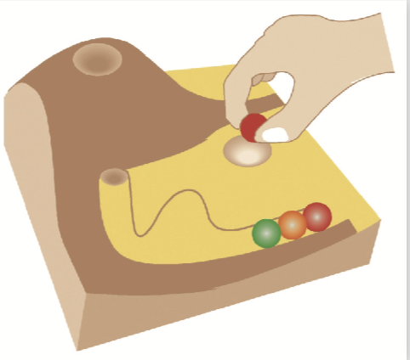
Good design
Marble answering machine (Bishop, 1995)
Based on how everyday objects behave
Easy, intuitive, and a pleasure to use
Only requires one-step actions to perform core tasks
www.id-book.com

Slide 10
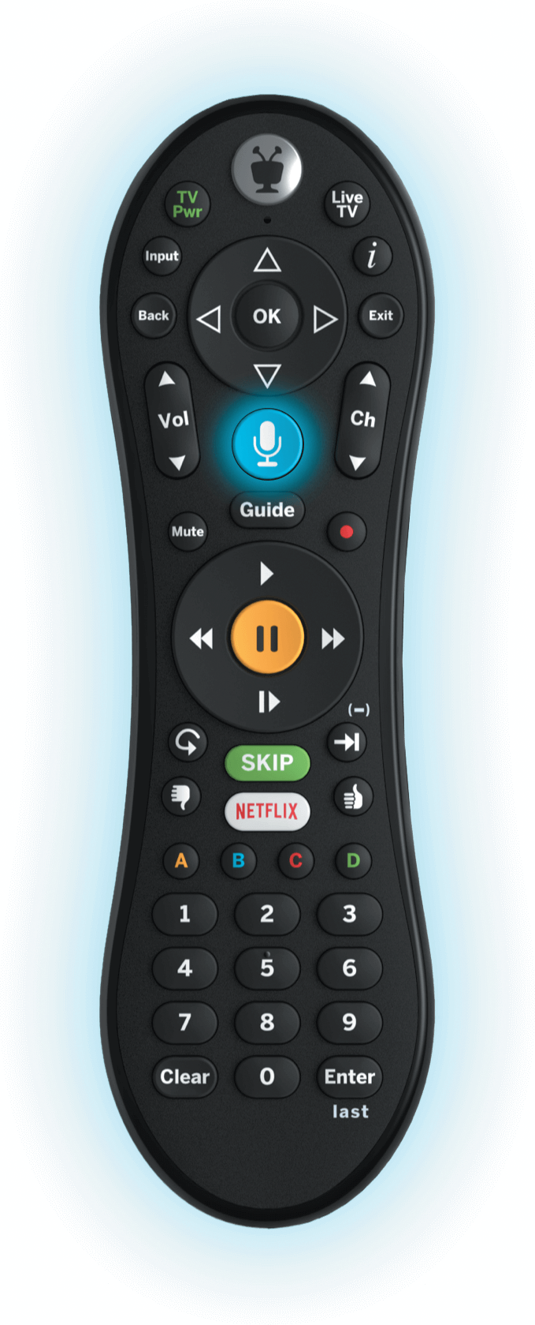
Good and bad design
Why is the TiVo remote much better designed than standard remote controls?
  Peanut shaped to fit in hand
  Logical layout and color-coded, distinctive buttons
  Easy-to-locate buttons
www.id-book.com

Slide 11
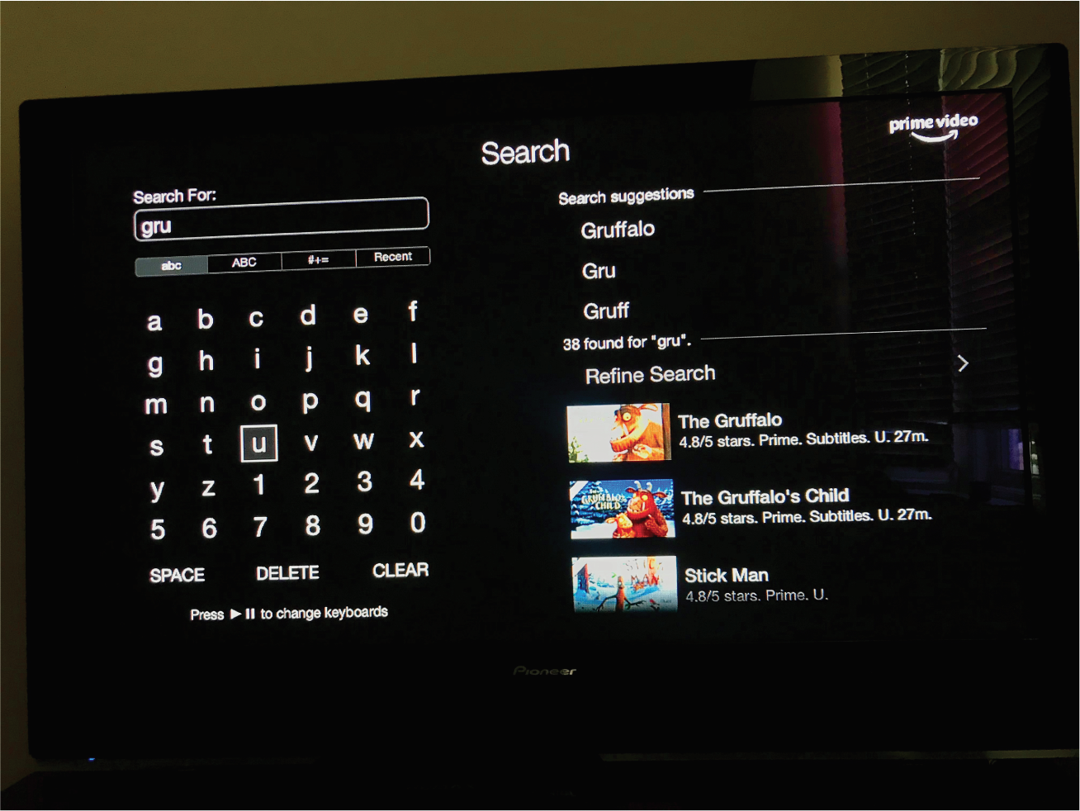
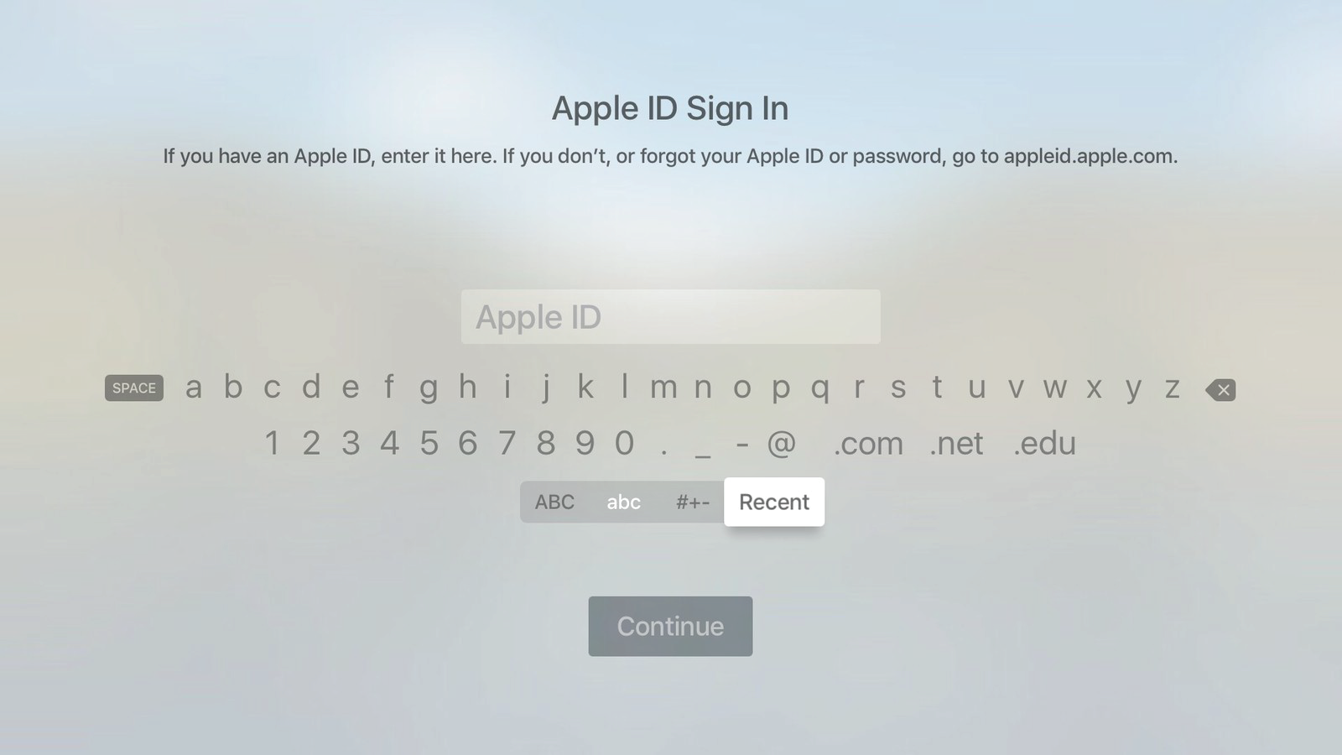
Dilemma
Which is the best way to interact with a smart TV? Why?
Pecking using a grid keyboard via a remote control
Swiping across two alphanumeric rows using a touchpad on a remote control
Voice control using remote or smart speaker
www.id-book.com

Slide 12
Information overload
Imagine you are a driver along this road on a Tuesday morning at 9 a.m. Can you park at this spot? What sounds like a simple question takes a lot of mental processing to answer.
As designers, we’re often faced with situations where we have to design for a lot of information to be displayed in a small space. The parking signs in LA might be an extreme case, but many times designing for mobile apps means facing the same problems. Is there a way out—for both the parking signs and designers in general?
http://fpt.edu.vn

Slide 13
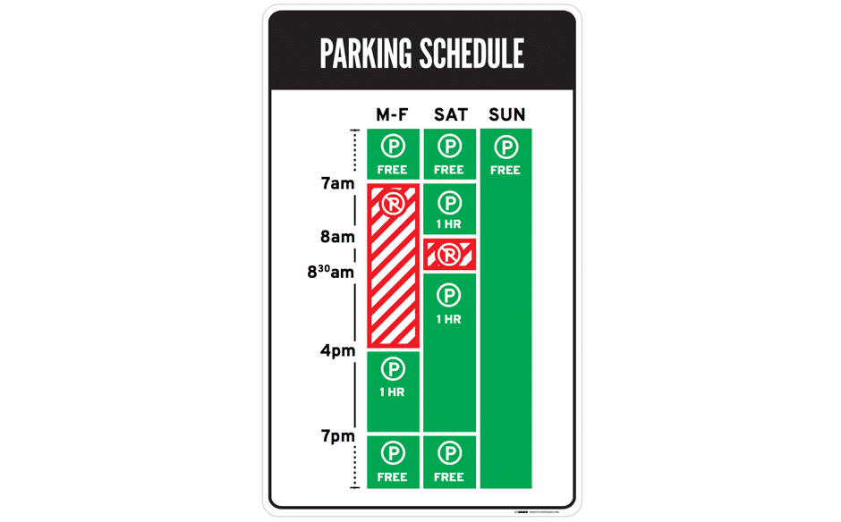
a. Information overload
The Good: Nikki Sylianteng’s Parking Sign
Designing a sign to display all the information, while being easy to understand, sounds like an impossible task. But that’s exactly what Brooklyn designer Nikki Sylianteng did.
Author/Copyright holder: Nikki Sylianteng. Copyright terms and licence: CC BY-NC-SA 4.0
http://fpt.edu.vn

Slide 14
Information overload
Lessons Learnt: Best Practice
Understand what your users need, then design based on that. This helps reduce information overload.
Have lots of information to convey to your users? Try using visuals instead of text.
http://fpt.edu.vn

Slide 15
What to design
Need to take into account:
  Who the users are
  What activities are being carried out
  Where interaction is taking place
Need to optimize the interactions users have with a product:
  So that they match the users’ activities and needs
www.id-book.com

Slide 16
What to design
“Designing interactive products to support the way people communicate and interact in their everyday and working lives.”
      Sharp, Rogers, and Preece (2019)
“The design of spaces for human communication and interaction.”
      Winograd (1997)
www.id-book.com

Slide 17
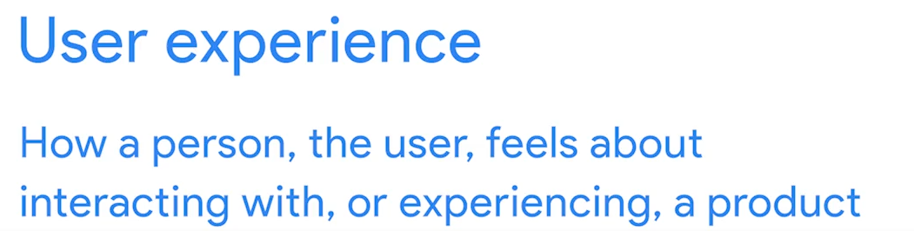

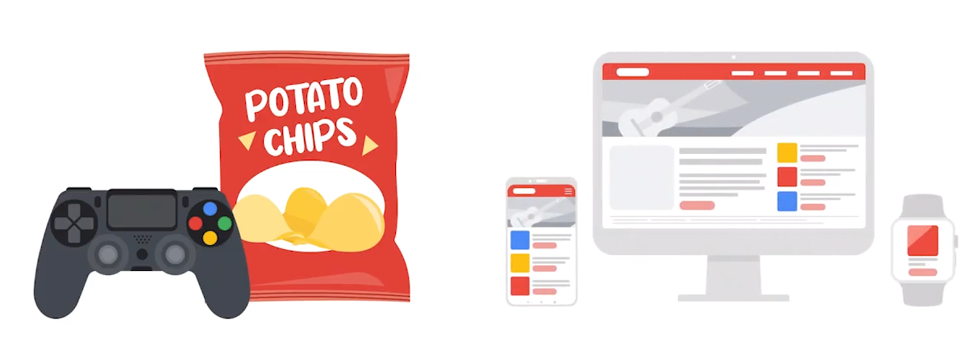
1. What is User Experience design?
User experience (UX) design is the process design teams use to create products that provide meaningful and relevant experiences to users. UX design involves the design of the entire process of acquiring and integrating the product, including aspects of branding, design, usability and function.
http://fpt.edu.vn

Slide 18
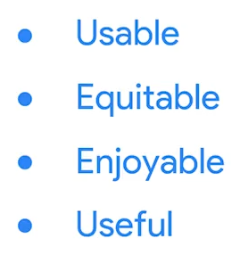
1. What is User Experience design?
User experience means improving usability or making something easy to use. The design of the product need to be clear to every one.
For user to have a good experience in product, the product need to have
http://fpt.edu.vn

Slide 19
The Factors that Influence User Experience
There are 7 factors that describe user experience, according to Peter Morville a pioneer in the UX field who was written several best-selling books and advises many Fortune 500 companies on UX:
Useful / Usable
Findable / Credible
Desirable / Accessible
Valuable
http://fpt.edu.vn

Slide 20
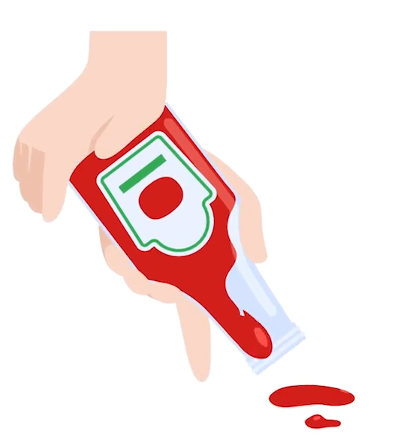
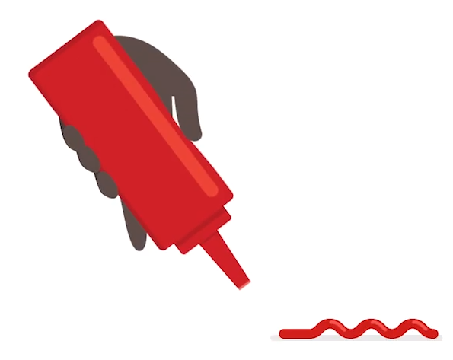
The Factors that Influence User Experience
Usable:
Designing an experience includes not only making the software easy to use but also designing the other experiences related to the product, for example, the marketing campaign, the packaging and after-sales support. Most importantly, UX design is concerned with delivering solutions that address pain points and needs. After all, no one will use a product that serves no purpose.
http://fpt.edu.vn

Slide 21

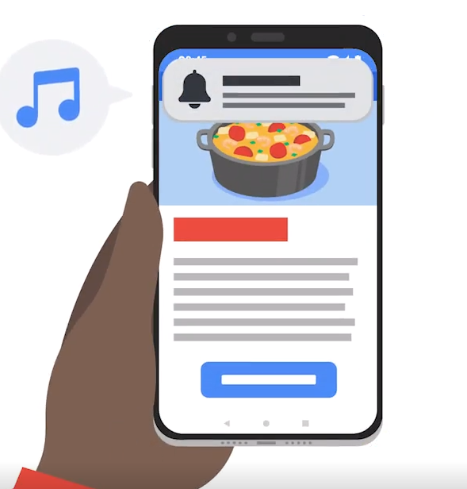
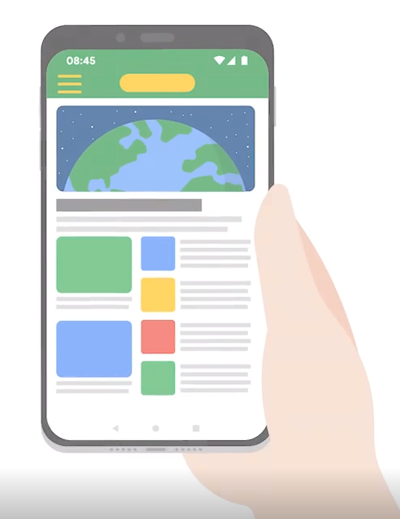

The Factors that Influence User Experience
Equitable
UX designer need to think about every person who uses the product, this might include people with disability and people experience different life.
http://fpt.edu.vn

Slide 22
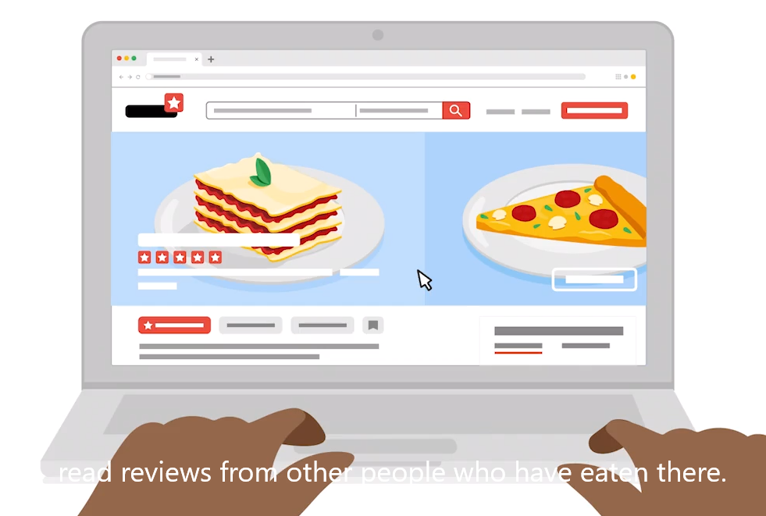
The Factors that Influence User Experience
Enjoyable
Create the positive connection between user and product, by taking user though and feeling into account when making products.
http://fpt.edu.vn

Slide 23

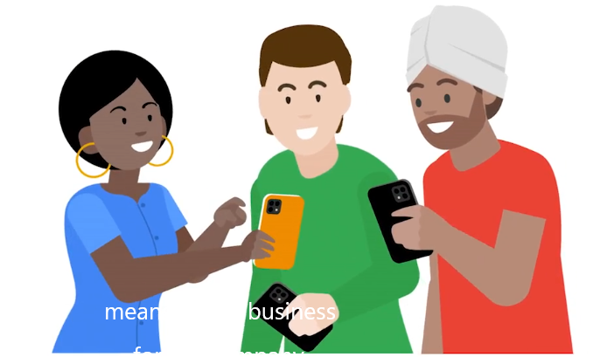
The Factors that Influence User Experience
Useful
Means product can solve the problem
http://fpt.edu.vn

Slide 24
The Factors that Influence User Experience
Findable
Findable refers to the idea that the product must be easy to find and in the instance of digital and information products; the content within them must be easy to find too. If you cannot find a product, you’re not going to buy it and that is true for all potential users of that product.
If you picked up a newspaper and all the stories within it were allocated page space at random, rather than being organized into sections such as Sport, Entertainment, Business, etc. you would probably find reading the newspaper a very frustrating experience. Findability is vital to the user experience of many products.
http://fpt.edu.vn

Slide 25
The Factors that Influence User Experience
Credible
It is nearly impossible to deliver a user experience if the user thinks the product creator is a lying, clown with bad intentions – they’ll take their business elsewhere instead.
http://fpt.edu.vn

Slide 26
The Factors that Influence User Experience
Desirable
Desirability is conveyed in design through branding, image, identity, aesthetics and emotional design. The more desirable a product is – the more likely it is that the user who has it will brag about it and create desire in other users.
http://fpt.edu.vn

Slide 27
The Factors that Influence User Experience
Accessible
Sadly, accessibility often gets lost in the mix when creating user experiences. Accessibility is about providing an experience which can be accessed by users of a full range of abilities – this includes those who are disabled in some respect such as hearing loss, impaired vision, motion impaired or learning impaired.
Design for accessibility is often seen by companies as a waste of money because the impression is that people with disabilities make up a small segment of the population. In fact, in the United States at least 19% of people have a disability according to the census data and it is likely that this number is higher in less developed nations.
http://fpt.edu.vn

Slide 28
The Factors that Influence User Experience
Valuable
Finally, the product must deliver value. It must deliver value to the business which creates it and to the user who buys or uses it. Without value it is likely that any initial success of a product will eventually be undermined.
Designers should bear in mind that value is one of the key influences on purchasing decisions. A $100 product that solves a $10,000 problem is one that is likely to succeed; a $10,000 product that solves a $100 problem is much less likely to do so.
http://fpt.edu.vn

Slide 29
The Take Away
The success of a product depends on more than utility and usability alone. Products which are usable, useful, findable, accessible, credible, valuable and desirable are much more likely to succeed in the market place.
http://fpt.edu.vn

Slide 30
2. What UX Designers Do Goes Beyond UI Design
“No product is an island. A product is more than the product. It is a cohesive, integrated set of experiences. Think through all of the stages of a product or service – from initial intentions through final reflections, from the first usage to help, service, and maintenance. Make them all work together seamlessly.”
— Don Norman, inventor of the term “User Experience.”
http://fpt.edu.vn

Slide 31
2. What UX Designers Do Goes Beyond UI Design
Products that provide a great user experience (e.g., the iPhone) are thus designed with the product’s consumption or use in mind and the entire process of acquiring, owning and even troubleshooting it. Similarly, UX designers don’t just focus on creating usable products; they concentrate on other aspects of the user experience, such as pleasure, efficiency and fun. Consequently, there is no single definition of a good user experience. Instead, a good user experience meets a particular user’s needs in the specific context where they use the product.
http://fpt.edu.vn

Slide 32

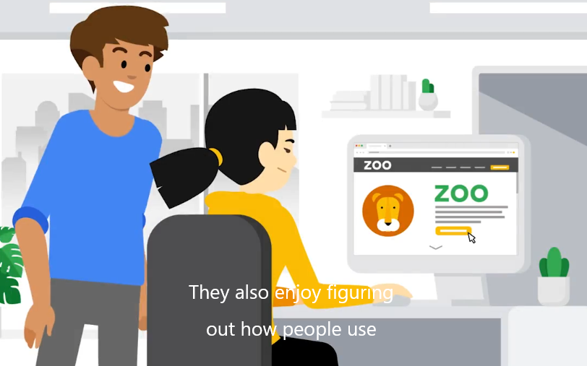
What Do UX Designers Do?
User research, persona development, information architecture (IA), wireframing, prototyping and high-fidelity design, and user testing are some of the responsibilities of a UX Designer.
UX designer might come from different background
http://fpt.edu.vn

Slide 33
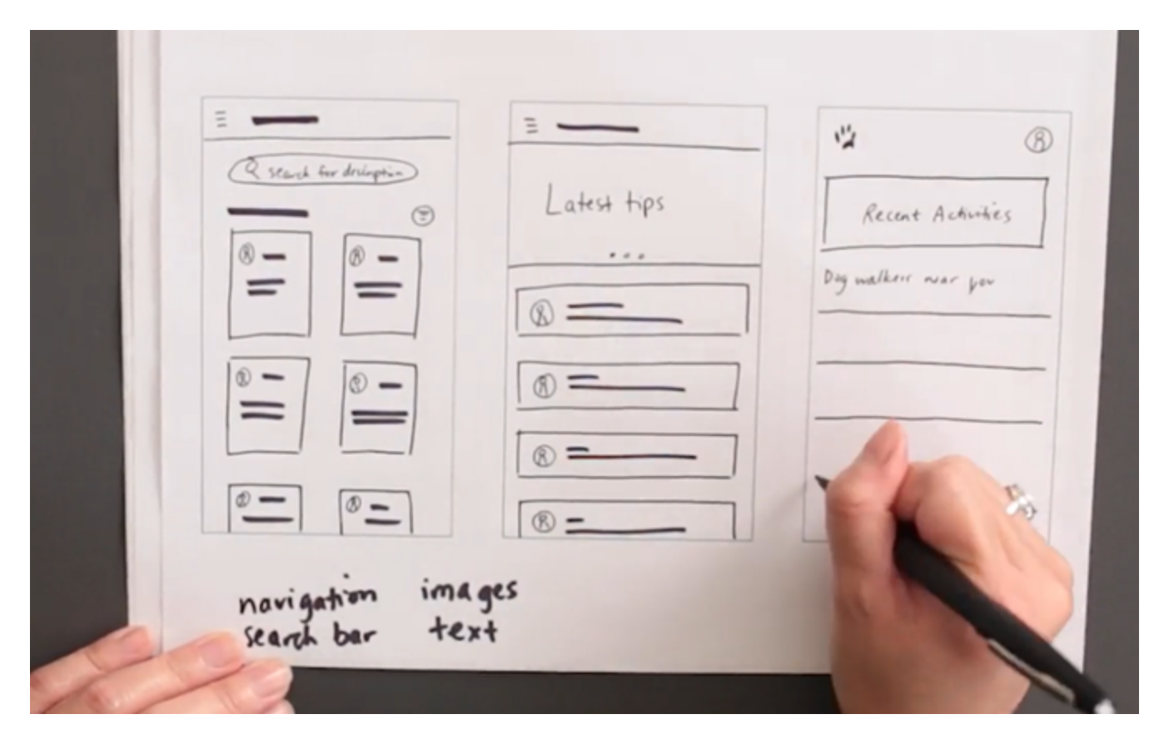
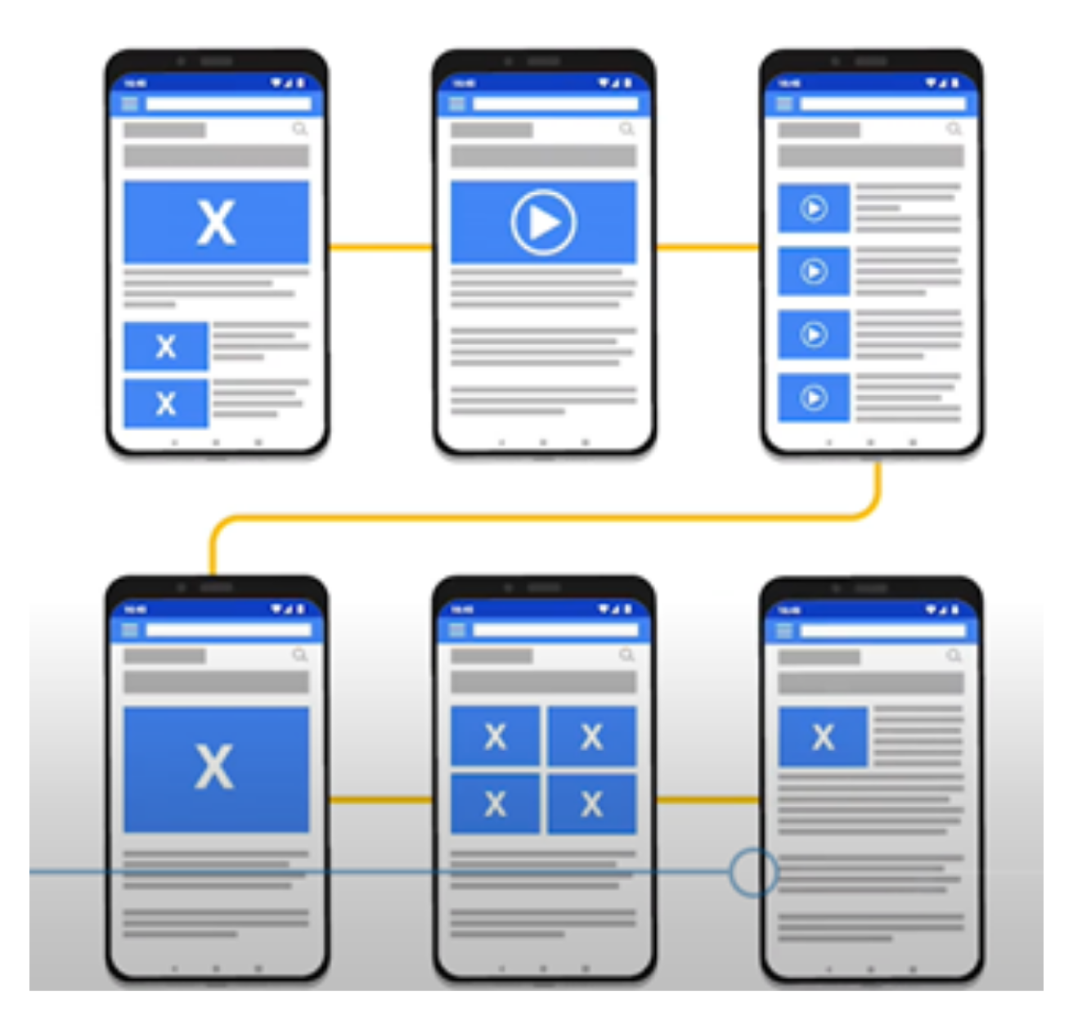
UX Design Output: Digital wireframe
Use actual content for important pieces of text

Slide 34
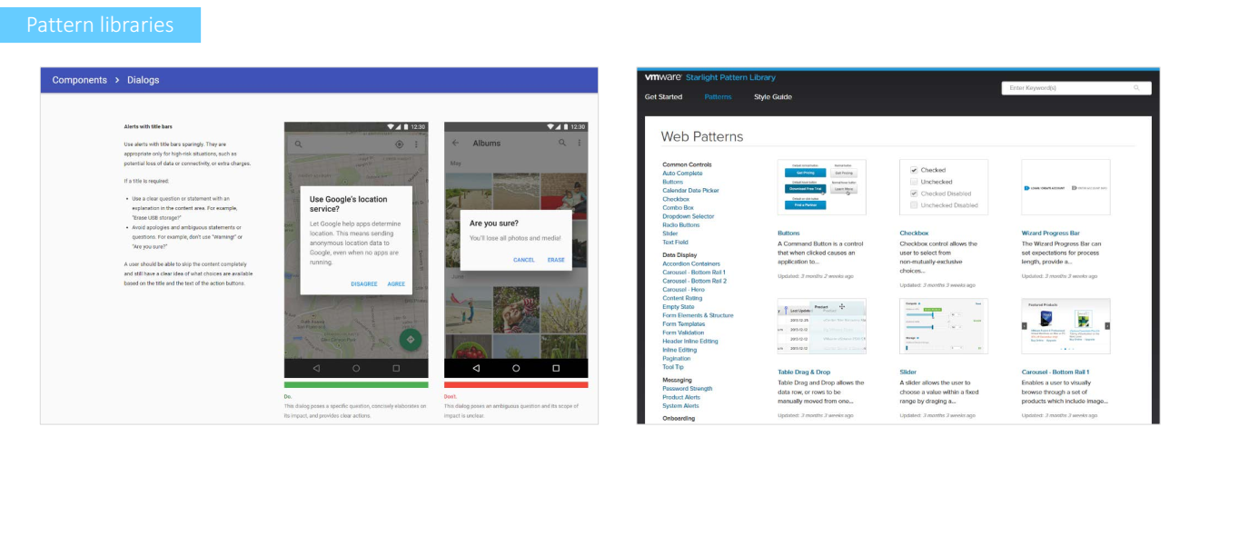
UX Design Output

Slide 35
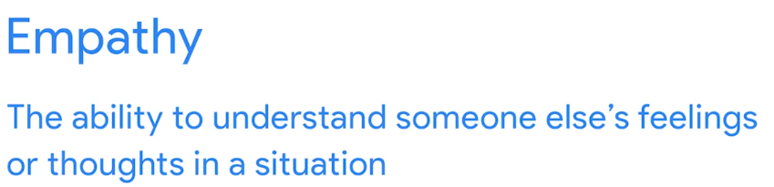
Skills Required to Become a UX Designer
1. UX Research Skills
Researchers and analysts who work on user experience projects should be able to collect and analyze both qualitative and quantitative data on their subjects.
Research methods used include user interviews (either open-ended or structured), user observation in the real world or a controlled testing environment, survey distribution, and focus groups.
http://fpt.edu.vn

Slide 36

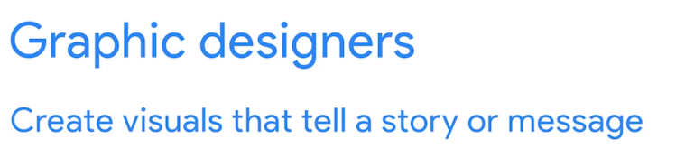
2-Ability to Wireframe and Prototype
A wireframe is a visual representation of the page's layout for a website.
Draw diagrams of UI elements like images, CTA buttons, and menus. Mockups, or early versions of a product, are made to test a concept or procedure after the wireframes have been accepted.
http://fpt.edu.vn

Slide 37
3. UX Writing Skills
Writing about user experience (UX) is a specialized skill set. Microcopy, or the words we read or hear when using a digital product, is a critical component of website navigability and the overall experience. Having strong UX writing abilities can help you achieve this goal.
http://fpt.edu.vn

Slide 38
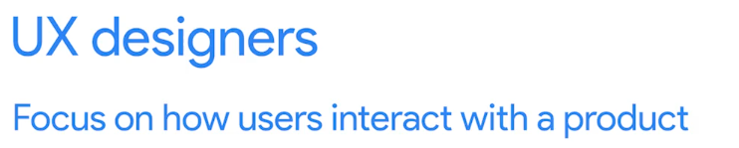
4. Interaction Design Skills
User-friendly interfaces are essential for digital products that are meant to be used by the general public.
There are several factors that influence the way a product is utilized by a user, such as aesthetics, motion, sound, and the physical space in which the product is used. It's imperative that you pay attention to user flow, information access, and screen layout.
http://fpt.edu.vn

Slide 39
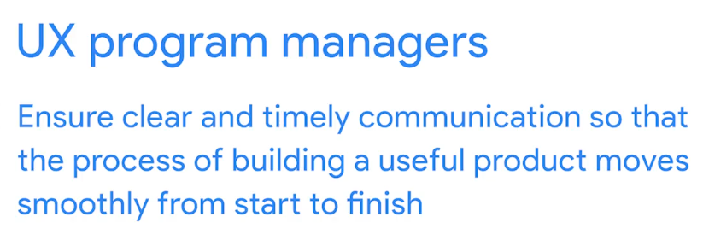
5. Visual Communication Skills
When it comes to user experience, visual design is more than just how a website appears and feels.
Think of the playback button or even the hamburger menu when you envision a standardized user interface piece. It's clear to everybody who sees these icons that they're clickable, and know what they mean.
http://fpt.edu.vn

Slide 40
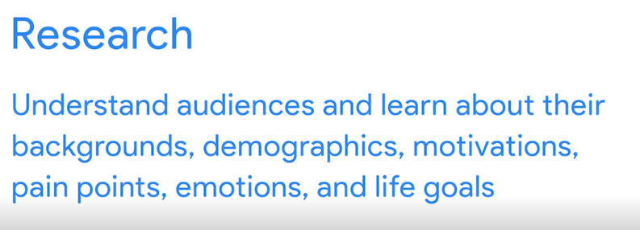
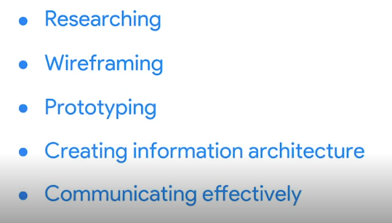

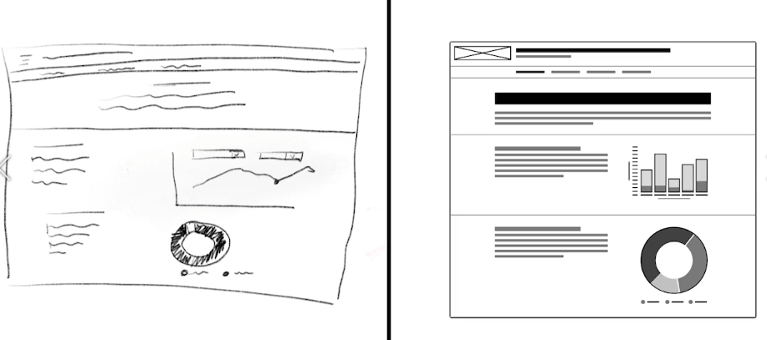
Responsible job of entry-level UX designer
Doing a lot of tasks for entry level UX designer
http://fpt.edu.vn

Slide 41
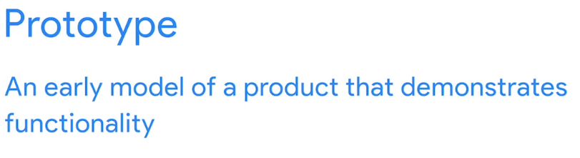
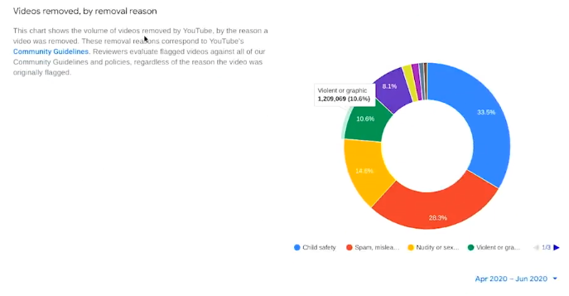
Responsible job of entry-level UX designer
Doing a lot of tasks for entry level UX designer
http://fpt.edu.vn

Slide 42
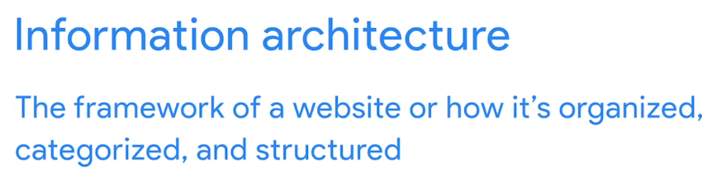
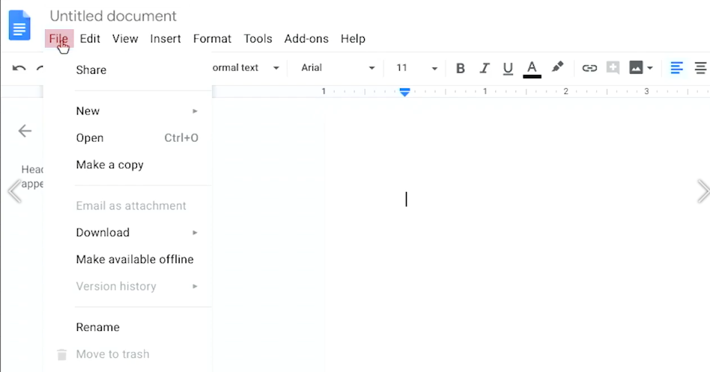

Responsible job of entry-level UX designer
Doing a lot of tasks for entry level UX designer
http://fpt.edu.vn

Slide 43
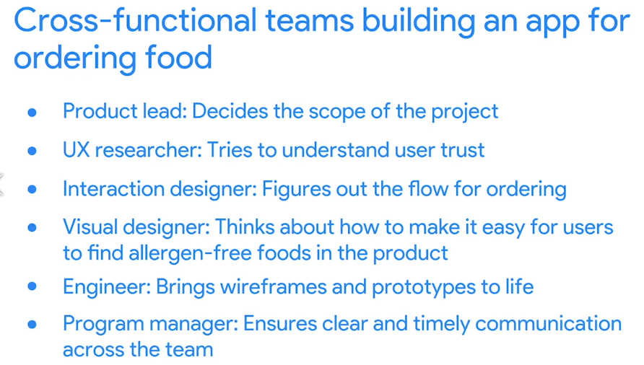
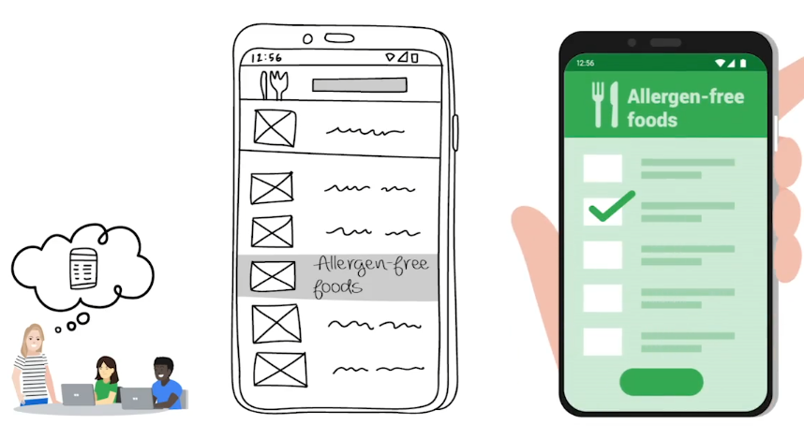
Work in a cross-fuctional team
http://fpt.edu.vn

Slide 44
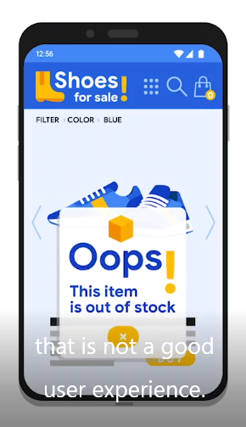
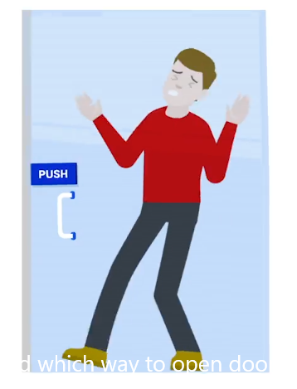
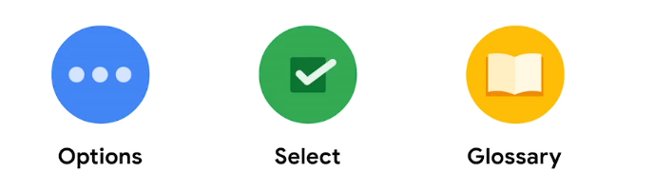
Design for a good user experience
Well-design application can leave empty space by using icon instead of text. Icon are easy to look at and easy to understand.
Create a product easy to use
http://fpt.edu.vn

Slide 45
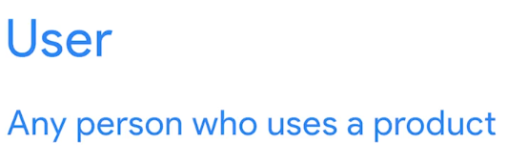
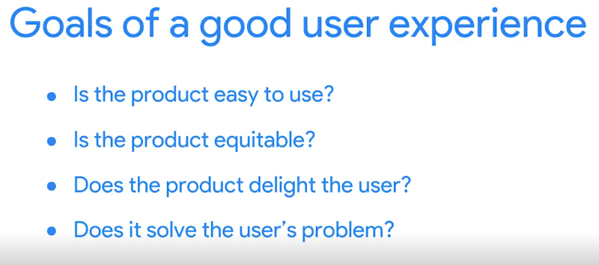
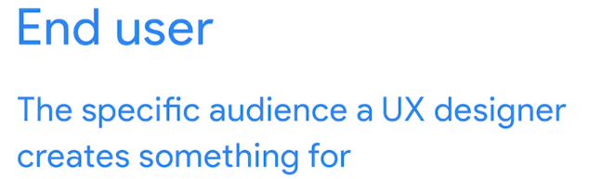
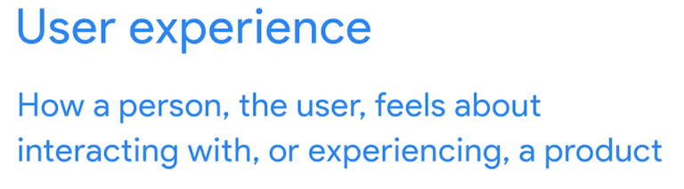
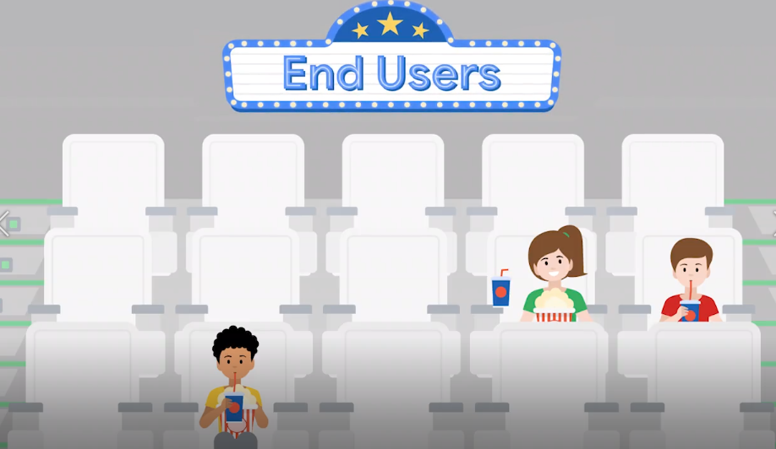
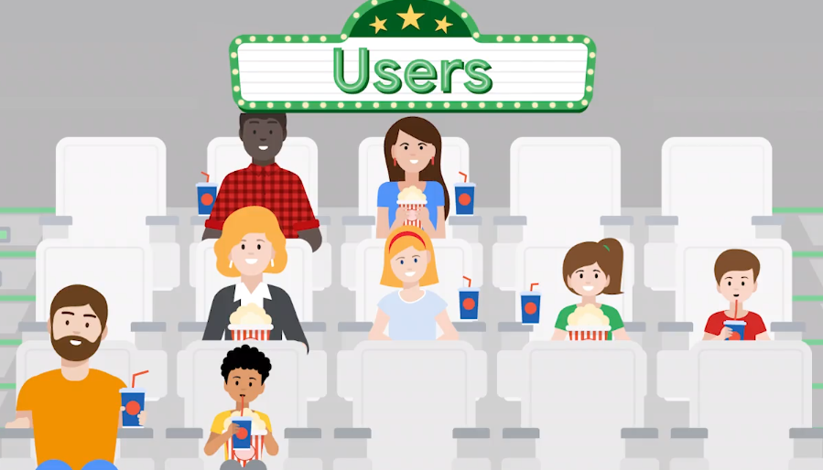
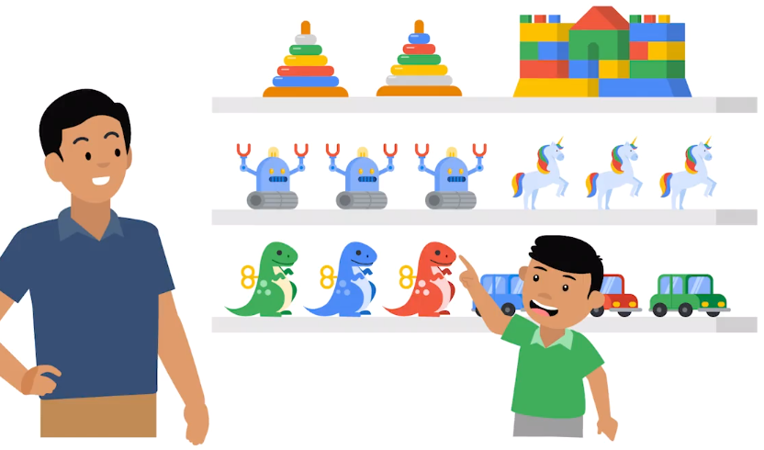
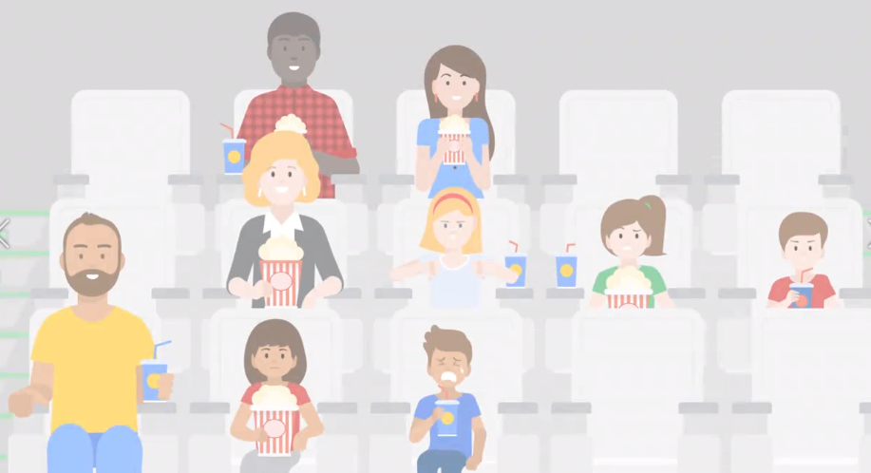
User, End User and User Experience
http://fpt.edu.vn

Slide 46
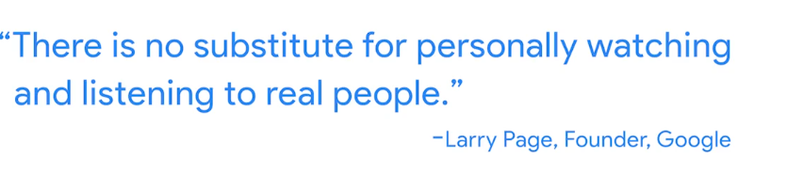

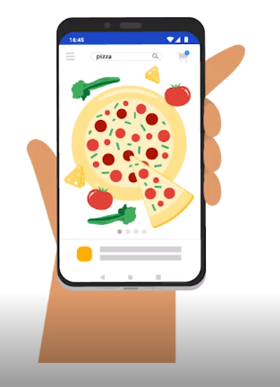
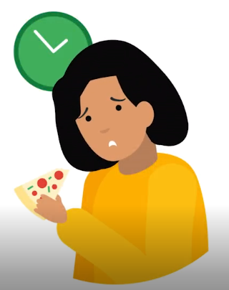
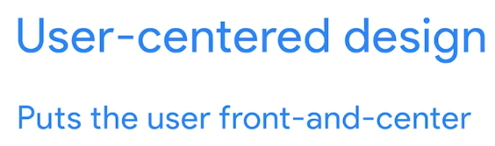
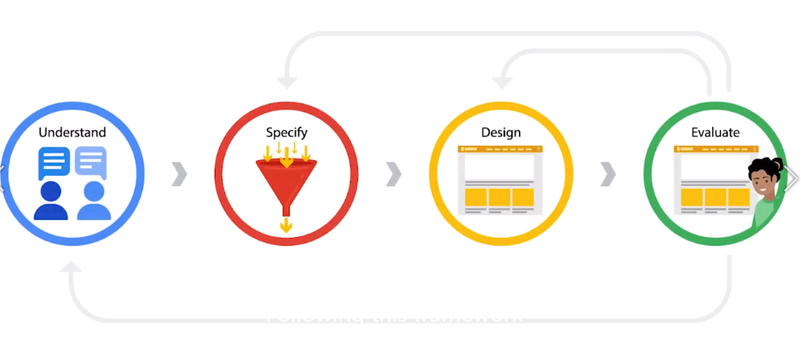


Prioritize the user
Focus on user problem reduces the impact of designer bias.
http://fpt.edu.vn

Slide 47
Universal, inclusive and equity-focus design
Universal design is the process of creating one product for users with the widest range of abilities and in the widest range of situations. Think of it like a one-size-fits-all approach.
Designers propose one solution for everyone. The problem is that when you focus on creating one solution for everyone, the designs lose their effectiveness. It's often difficult to achieve any goals with your product when you have so many intended users.
It's like when you go to a store that sells a hat in just one size, the label might read, "One-size-fits-all," but the hat still won't fit a lot of people. Universal design had the same problem. Even though it had the intention of being inclusive, it excluded a lot of people.
http://fpt.edu.vn

Slide 48

Universal design
It turns out one-size-fits-all isn't a great solution. As UX designers realized that universal design didn't meet the needs of every user, the approach to including people began to change.
http://fpt.edu.vn

Slide 49



Inclusive design
If universal design is a one-size-fits-all solution, then inclusive design can be described as "solve for one, extend to many." With inclusive design, you solve for one type of user, and the benefit of that solution can extend to many other types of users.
Our goal as designers is to build experiences that are accessible to users with the widest range of abilities. In other words, no one should be excluded from using...
http://fpt.edu.vn

Slide 50





Equity-focus design
http://fpt.edu.vn

Slide 51



The importance of accessibility
The term "accessibility" refers to the design of products, devices, services, or environments for people with disabilities.
Accessibility in four big categories:
  People with motor disabilities;
  People who are deaf or hard of hearing;
  People with cognitive disabilities, like developmental, learning, or intellectual disabilities;
  People with vision disabilities.
http://fpt.edu.vn

Slide 52

The importance of accessibility
Driving on a dark road late at night, your vision is probably not as clear as it would be in the daylight
Another example is if you're visiting a country where you don't speak the language, your hearing is situationally limited.
Think about inclusive product features that increase magnification, like enlarged font. Or features that help everyone understand videos, like Closed Captions.
Products that are originally adopted by the disability community can reach a wider audience.
http://fpt.edu.vn

Slide 53


The importance of accessibility
Here's the key takeaway: If we make the design of a product easier for people with disabilities, we also often make it a better experience for everyone else.
http://fpt.edu.vn

Slide 54
Assistive Technology
Understanding how people with disabilities use your product is crucial in UX design. Key assistive technologies include color modification, voice control, switch devices, screen readers, and alternative text.
Color modification, like high contrast or dark mode, enhances screen visibility for people with low vision and reduces eye strain. Voice control and switch devices help those with limited dexterity navigate devices without a keyboard or mouse.
Screen readers assist users with limited vision by reading text aloud and describing interactive elements and images. Alternative text (alt text) translates visual content into text, aiding those with low bandwidth or vision impairments.
Speech-to-text is another example that benefits everyone. It allows users to compose text by speaking, making it easier and more efficient than typing.
http://fpt.edu.vn

Slide 55


Assistive Technology
http://fpt.edu.vn

Slide 56



Design for users
http://fpt.edu.vn

Slide 57





The UX Design Tool
http://fpt.edu.vn

Slide 58




Get to know the platform
http://fpt.edu.vn

